Slide 1

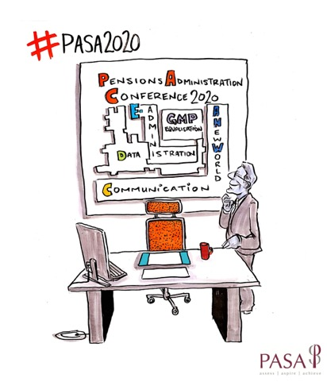











ANNUAL CONFERENCE
11 FEBRUARY 2020
Sponsored by:
Expert Partner
Expert Partner

Slide 2
Conference Opening address
Kim Gubler
Chair of PASA
#PASA2020

Slide 3
Keynote speaker
David Fairs
Executive Director for Regulatory Policy, Analysis and Advice
#PASA2020

Slide 4
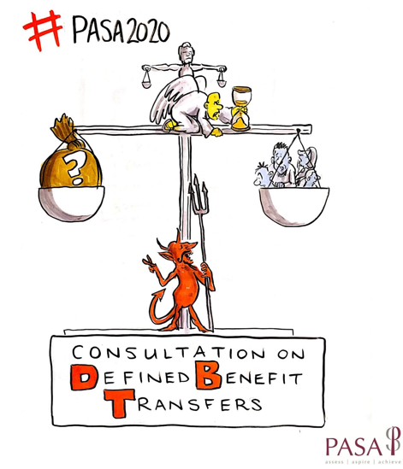
Faster, Safer DB Transfers
– a new consultation
Margaret Snowdon OBE
President of PASA
11 February 2020

Slide 5
DB Transfers: the facts
210,000 DB transfers 2018
DB transfers can take months to complete
Lots of reasons
  Process variability & confusion
  Lack of automation
  Third party involvement
  Scams risk
Reputational damage for firms
80% of transfers should be processed swiftly

Slide 6

DB Transfers 2: the sequel
PASA Guidance Part 1 last year
  Multi discipline Working Group and
  external reviewers
  Straightforward cases
  Definitions
  Set process standards
  Introduced the Transfer Template
We decided to write a Code instead of Part 2 guidance

Slide 7
Why a Code of Good Practice
We must process faster where we can
Guidance isn’t strong enough
End to end member experience is important
Complementary STAR initiative (DC)
  48 hours processing stages
  MI next year
  Performance league table
Pensions Minister interest
Opportunity to increase trust in the industry

Slide 8

A Code of Good Practice
Much of original guidance is retained
Key points:
  Voluntary
  Standard and Non-standard cases
  Out of scope cases
  Process standards and timescales
  Acknowledgement letter to member
  Due Diligence reflects PSIG Code
  Transfer Template
  Sample letters
  Read across to DC intended

Slide 9
Objectives and Principles
Objectives:
  Improve overall member experience through faster, safer transfers
  Improve communications and transparency in processing transfers
  Improve efficiency for administrators
Principles:
  Member comms should be fair, clear, unbiased & straightforward
  Members should be kept informed of delays
  Administrators should work with other stakeholders to encourage meeting Code objectives
  Comms should reflect best practice and use templates where possible
  Working practices should follow the Code and target timescales

Slide 10
Consultation questions
Are the principles right/practical?
Is the definition of a “standard case” right/workable?
Is the definition of a “non-standard case” right/ workable?
Are the proposed timescales realistic and achievable?
How much emphasis should there be on automation?
Should providing early retirement information alongside the transfer pack be standard?
Feedback on the quote and settlement process steps?
Comments on the Transfer Template?
Can we harmonise what constitutes a “valid transfer” for guarantee?
Should we notify member of reductions in TV on recalculation?
Should transfer payments be made by TT rather than BACS?
What would you like to see in Practitioner Notes?
What guidance wanted for administrators on safeguarded benefits?

Slide 11

Aiming for a Code of Good Practice
What next?
  Consultation window closes 30 April 2020
  Response to consultation input
  Code published September 2020
  Adoption period of 12 months (proposed)
  Quality mark for adopters?
  Part of accreditation scheme?
Document now available on the PASA website
Please respond to this consultation

Slide 12

Thank you – Any questions?

Slide 13
Coffee break
be back for 11.15
#PASA2020

Slide 14
Member communications – fit for purpose ?
Communication Panel
Chaired by – Justine Joy, Chair PASA PR committee
Panel: Andrew Moffitt, Ferrier Pearce
Joe Craig, Quietroom
#PASA2020

Slide 15
Lunch
be back for 13.15
#PASA2020

Slide 16
The pensions administration
market perspective
#PASA2020

Slide 17
PASA Annual Conference 2020
11 Feb 2020
Legal & General Investment Management
DC Master Trust administration - what's the difference?
Emma Douglas, Head of DC
Intended for professional clients only. Not to be distributed to retail clients.

Slide 18
Agenda
1
The new DC landscape
2
TPA vs. provider administration – what’s the difference?
3
Master Trust Trustee oversight
4
Transitioning into a Master Trust

Slide 19
The Trend
Legal Advisers
Investment Manager C
Trustees
Adviser to the Trustees
Master Trust
Third Party Administrator
TREND
Unbundled
Bundled
Investment Manager B
Annuity broker
Own Trust
Financial Adviser
In-house Administration
Investment Manager A

Slide 20
Bundled vs. Unbundled
UNBUNDLED
Administration and Investment services
performed separately
Trustees choose ‘Best of breed’
Investment Platform or direct relationship with external managers
Employer may pay administration charges
More tailoring
Additional costs for extra services
Higher fees
BUNDLED
Administration and investment services performed by one Provider
Full range of investment funds available
Member usually pays both investment and
administration charges
Administration fees lower
Standardised services
All-in charge

Slide 21





Contribution
Processing

Slide 22
Discretionary Processes
A different story
1
Death
Death
Provider
Beneficiary
2
Divorce
Death
In-house
team
DB
Adminstrator
Beneficiary
Complaints
&$!#%$!

Slide 23



The role of the trustees
Monitor transactions and service
Manage the service provider
Focus on:
  Accuracy
  Control Environment
  Reconciliations
Review systems capability and capacity
Oversee
  Risk Management
  IT security
  Disaster recovery
  Rectification of errors
Operations Committee

Slide 24


It’s an ‘arms race’
MY APP IS BETTER THAN YOUR APP!!

Slide 25
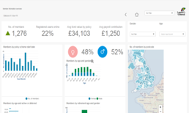

Continuous development
Management
Information
Post
Retirement
Financial
Wellbeing
Wider
Savings
Artificial
Intelligence
Virtual
Reality

Slide 26
Transitions
What to look out for when moving to a Master Trust
0010111001010010
000101100101000010
10110101001000101010
1010010101001010010110
1100010110011010111000
0001000010101101010101
101010101010100100101
10101010101010010101
1101010101001001100
101010101001010
Processes
Data
Administration teams
Document the processes
in detail!
Be prepared to make some changes if necessary
Have very clear ‘hand-offs’ between organisations
Is it clean?
What is transferring? Opening balance or full history?
How will the history be held?
Test and test again
Ringfenced?
Part of a bigger team – how is knowledge trained in?
Bespoke helpline?
Points of contact for
in-house teams

Slide 27

The successful
Master Trusts will
be able to incorporate the best of the
Provider and TPA approach to administration

Slide 28
Legal & General Investment Management
LGIM Disclaimer and important legal notice
The information contained in this document (the ‘Information’) has been prepared by Legal & General Investment Management Limited, or by Legal and General Assurance (Pensions Management) Limited and/or their affiliates (‘Legal & General’, ‘we’ or ‘us’). Such Information is the property and/or confidential information of Legal & General and may not be disclosed by you to any other person without the prior written consent of Legal & General.
No party shall have any right of action against Legal & General in relation to the accuracy or completeness of the Information, or any other written or oral information made available in connection with this publication. Any investment advice that we provide to you is based solely on the limited initial information which you have provided to us. No part of this or any other document or presentation provided by us shall be deemed to constitute ‘proper advice’ for the purposes of the Pensions Act 1995 (as amended). Any limited initial advice given relating to professional services will be further discussed and negotiated in order to agree formal investment guidelines which will form part of written contractual terms between the parties.
Past performance is no guarantee of future results. The value of an investment and any income taken from it is not guaranteed and can go down as well as up, you may not get back the amount you originally invested.
The Information has been produced for use by a professional investor and their advisors only. It should not be distributed without our permission.
The risks associated with each fund or investment strategy are set out in this publication, the relevant prospectus or investment management agreement (as applicable) and these should be read and understood before making any investment decisions. A copy of the relevant documentation can be obtained from your Client Relationship Manager.
Confidentiality and Limitations:
Unless otherwise agreed by Legal & General in writing, the Information in this document (a) is for information purposes only and we are not soliciting any action based on it, and (b) is not a recommendation to buy or sell securities or pursue a particular investment strategy; and (c) is not investment, legal, regulatory or tax advice. Any trading or investment decisions taken by you should be based on your own analysis and judgment (and/or that of your professional advisors) and not in reliance on us or the Information. To the fullest extent permitted by law, we exclude all representations, warranties, conditions, undertakings and all other terms of any kind, implied by statute or common law, with respect to the Information including (without limitation) any representations as to the quality, suitability, accuracy or completeness of the Information.
Any projections, estimates or forecasts included in the Information (a) shall not constitute a guarantee of future events, (b) may not consider or reflect all possible future events or conditions relevant to you (for example, market disruption events); and (c) may be based on assumptions or simplifications that may not be relevant to you.
The Information is provided ‘as is' and 'as available’. To the fullest extent permitted by law, Legal & General accepts no liability to you or any other recipient of the Information for any loss, damage or cost arising from, or in connection with, any use or reliance on the Information. Without limiting the generality of the foregoing, Legal & General does not accept any liability for any indirect, special or consequential loss howsoever caused and on any theory or liability, whether in contract or tort (including negligence) or otherwise, even if Legal & General has been advised of the possibility of such loss.
Third Party Data:
Where this document contains third party data ('Third Party Data’), we cannot guarantee the accuracy, completeness or reliability of such Third Party Data and accept no responsibility or liability whatsoever in respect of such Third Party Data.
Publication, Amendments and Updates:
We are under no obligation to update or amend the Information or correct any errors in the Information following the date it was delivered to you. Legal & General reserves the right to update this document and/or the Information at any time and without notice.
Although the Information contained in this document is believed to be correct as at the time of printing or publication, no assurance can be given to you that this document is complete or accurate in the light of information that may become available after its publication. The Information may not take into account any relevant events, facts or conditions that have occurred after the publication or printing of this document.
Telephone Recording
As required under applicable laws Legal & General will record all telephone and electronic communications and conversations with you that result or may result in the undertaking of transactions in financial instruments on your behalf. Such records will be kept for a period of five years (or up to seven years upon request from the Financial Conduct Authority (or such successor from time to time)) and will be provided to you upon request.
Legal & General Investment Management Limited. Registered in England and Wales No. 02091894. Registered Office: One Coleman Street, London, EC2R 5AA. Authorised and regulated by the Financial Conduct Authority, No. 119272.
Legal and General Assurance (Pensions Management) Limited. Registered in England and Wales No. 01006112. Registered Office: One Coleman Street, London, EC2R 5AA. Authorised by the Prudential Regulation Authority and regulated by the Financial Conduct Authority and the Prudential Regulation Authority, No. 202202.
The LGIM Workplace Savings division on behalf of both Legal and General Assurance Limited. Registered in England and Wales No. 00166055. Authorised by the Prudential Regulation Authority and regulated by the Financial Conduct Authority and the Prudential Regulation Authority. As well as Legal & General (Portfolio Management Services) Limited. Registered in England and Wales No. 02457525. Authorised and regulated by the Financial Conduct Authority, No. 146786. Registered Offices: One Coleman Street, London, EC2R 5AA.
Notes:
Disclaimer covers institutional, retail and DC as at 1 January 2018 and incorporates the MIFIDD II requirement regarding telephone recordings.

Slide 29
Coffee break
be back for 15.00
#PASA2020

Slide 30


KNOW YOUR CUSTOMER
Be Accurate. Be Compliant. Be Innovative.
Lisa Lyon, Managing Director, Target Professional Services
PASA Annual Conference
11th February 2020
Incorporating

Slide 31





Target Professional Services
Market leading global tracing and
data verification specialists
Over 15 million records within the pensions sector
Achieve 95% accuracy of data or above
Respect Integrity Passion Innovation

Slide 32


Data accuracy >95%
Verification of data
Member engagement

Slide 33



Mortality screen
Tracing
Online portal
Life certification

Slide 34


Slide 35



Consumer has moved on

Slide 36

Are you talking to the right person?
Are they still alive?
Do they still live at the same address?
Can they easily update their address?

Slide 37


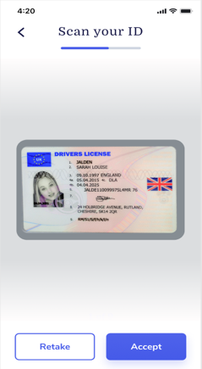



Are you talking to the right person?
Scanned Photo ID matched
to a selfie

Slide 38

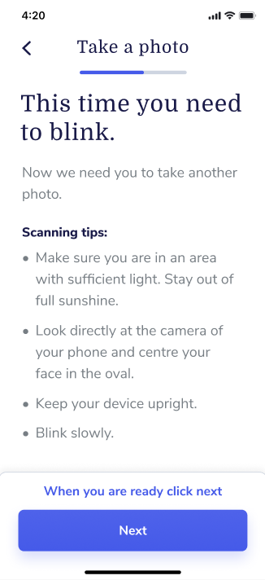

Are they still alive?
Blink to capture the selfie to confirm alive

Slide 39

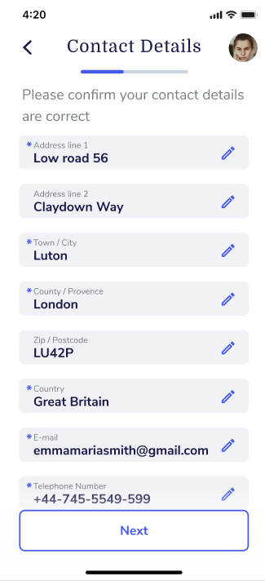
Simply confirm or update address
…with a blink
for verification

Slide 40

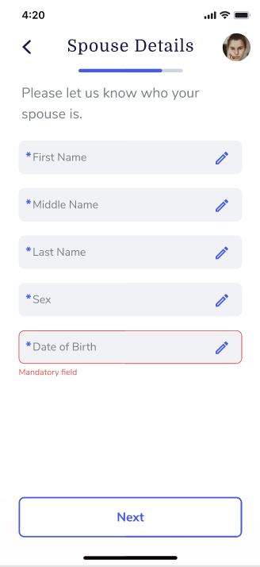
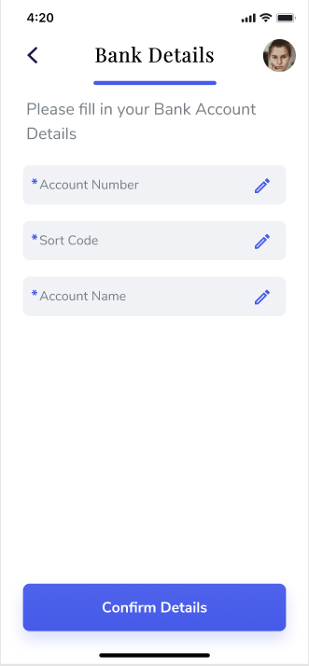
Add spousal or banking details
Again a blink is required to update details

Slide 41

Case Study of mypensionID
Over 4,500 pensioners in 92 countries contacted as part of an existence check exercise
Average age of scheme members contacted was 68
Offered mail or portal upload of certified documents or verification by mypensionID mobile app
Over 70% of pensioners who'd previously verified by post were converted to the mypensionID app
40% of responses previously verified by post now have consented email addresses confirmed allowing GDPR compliant contact via this medium
Oldest pensioner digitally verified via mypensionID was 93 years old

Slide 42

Oldest user 93
40% of users NEW to digital
78% of UK have a mobile device
81% of USA have a mobile device
Two thirds of the world use a mobile device

Slide 43
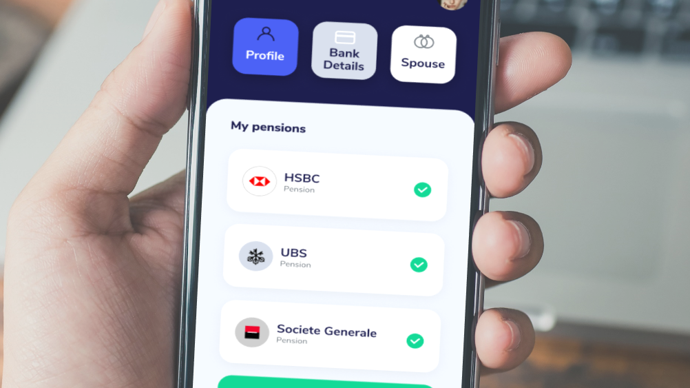
Allow members to keep their data up to date…
…simply, securely
and easily

Slide 44




Can we do more?

Slide 45
Thank you
Lisa Lyon, Managing Director, Target Professional Services
PASA Annual Conference
11th February 2020
Incorporating

Slide 46
GMP Equalisation
What is stopping us equalising?
Duncan Buchanan – Hogan Lovells – February 2020

Slide 47


October 2018
Must equalise for the effects of GMPs relating to the period 17 May 1990 – 5 April 1997
Various methods approved (B, C2 and D2)
Need to correct for the past as well as for the future
Sounds simple!

Slide 48
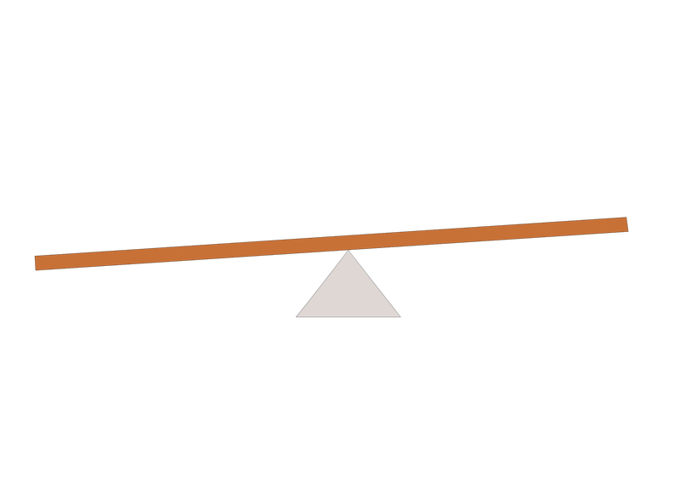
Correcting for the past
Year on Year – Methods B or C
Lower increases on member liabilities
Cost of administration

Slide 49
Pension starts after deferment over age 60
Male gets £10 pa uplift to pension and £321 plus interest
Male pension would overtake female (no accumulation) – Method B
Male gets £91 plus interest and pension drops by at least £48 pa
Male pension would overtake accumulated female Method C1
Male pension would overtake accumulated female with interest Method C2

Slide 50
Correcting for the future
Year on Year – Methods B or C
Also option to convert GMP and equalise – Method D2
Upfront cost of once and done conversion
Ongoing cost of year on year

Slide 51
Correcting for the future –the conversion option (D2)
Lloyds example converts all pension to increase at same rate (assumed to be 3.85% pa) – hence lower pension to start
Minimum interference approach continues to increase X-GMP element at lower rate (assumed to be 2.06% pa) – similar expected income stream
Non escalating approach removes all increases to future pension (note lawyer figures!)

Slide 52
So what is stopping us equalising?
Unanswered questions
Data Issues
Tax Issues
Another Lloyds Bank case
GMP conversion legislation - uncertainty
Communication
Not wanting to be the first
Administrators building new systems

Slide 53

Unanswered questions
Methodology sub-group formed
Identified a number of "dark corners"
Court will not be asked to rule on them
Pragmatic/practical approaches
Generally well received
Main discussion around:
  De-minimis recommendations
  Transfers in
Worked examples in Appendix

Slide 54
Data issues - constructing the comparator
1985
1988
1990
1997
2005
2015
2021
Member
Joins Scheme
Barber day
Changes to GMPs
Date of leaving
Pension started
Equalisation date
Changes to GMPs
Member
Apply revaluation to GMP and Excess
Apply scheme increases to GMP and Excess
Comparator
Treat as if opposite sex 1990/97 – adjust GMP and excess
Need to go back to DOL when equalising
Don’t forget Anti-franking at 60/65!

Slide 55
Data issues
Equalisation means going back to date member's date of leaving
Availability of data will be a significant issue for most schemes
Need to construct a comparator for each member
Data Sub-group of GMP Equalisation Working Group
Guidance to be published shortly which will include:
  Different Calculation Solutions – eg Roll Back or Reconstruction approaches
  Pragmatic approaches to calculating opposite sex GMP
Forfeiture rules will not avoid need to go back 30 years

Slide 56
Tax issues
Tax Sub-group of GMP Equalisation Working Group
HMRC guidance was expected in December (not on conversion)
Issues for schemes are:
  Lifetime Allowance – is adjustment to pension a BCE2 (revisit original or new) or BCE3
  Annual Allowance – particularly on conversion
  Members with LTA protections
  Unauthorised payments – transfers out and trivial commutations
  Deferred member carve out where GMP is converted

Slide 57
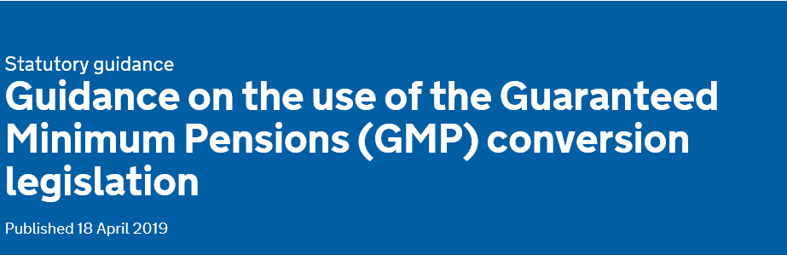
Issues with GMP equalisation legislation
Conversion needs "Employer" consent
Members need to be "consulted" before conversion
Converted scheme must provide minimum level of contingent spouse
Pensions Bill 2020 currently silent on GMP conversion
Would be good if conversion took place when benefits come into payment (but legislation is clunky)

Slide 58
Conclusions
Schemes unlikely to equalise until tax position is clearer
Most ongoing schemes looking at 2021/2022 to equalise
Schemes can start to prepare now – Call to Action
Issues about linking in with GMP reconciliation/rectification exercises
Schemes taking steps to equalise transfer values for effects of GMPs
Schemes winding up are having to take steps to equalise GMPs

Slide 59
Conference Closing Remarks
Kim Gubler
Chair of PASA
#PASA2020

